Slide 1
DIGITAL GRID – ASSET MANAGEMENT
Demo Script
Sep 2018

Slide 2

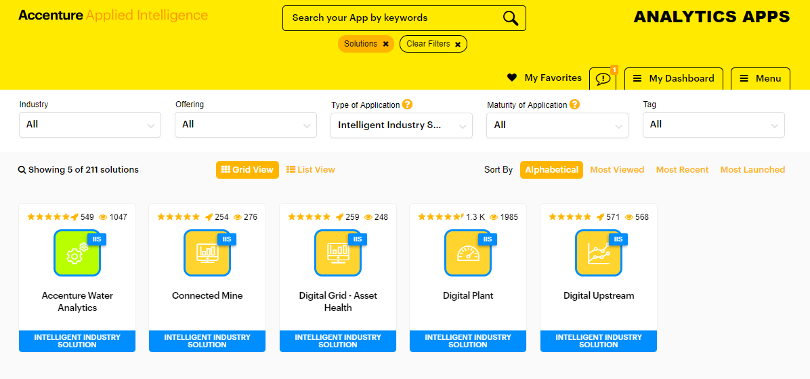
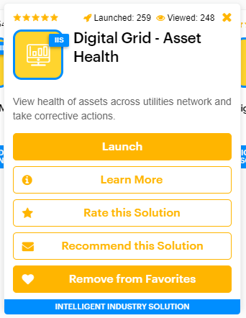
Connecting to the Asset Health Application Via AIP App Gallery
Open the following link in Chrome: https://analyticapps.accenture.com/
On the main dashboard page, select Type of Application = Intelligent Industry Solutions this will open showing the main industry solutions currently available
Click on Digital Grid – Asset Health tile to view the pop up On the pop up, select
Launch – will launch the application
Learn More will open an information page containing stage0 deck,
talk tracks and supporting materials for the application and demo
Rate / Recommend Solution allows users to rate and feedback on the application
AIP App gallery apps are available anyone with an Accenture Enterprise ID.

Slide 3
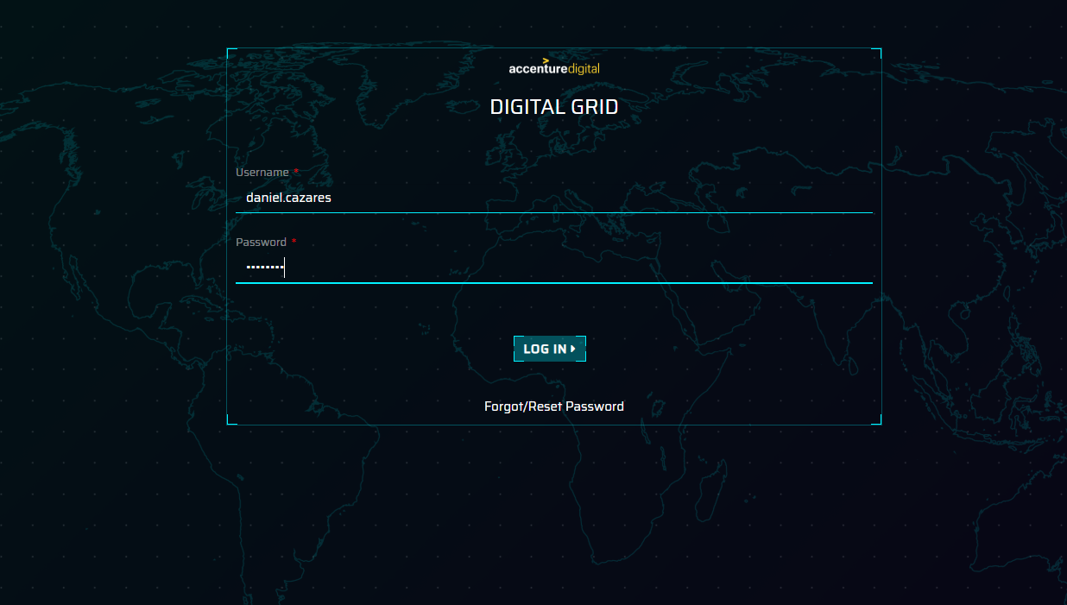
Connecting to the Asset Health Application Via AIP App Gallery
Open the following link in Chrome:
http://analyticappsshiny.accenture.com/digitalgrid/dist/#/login
This is the first screen the user sees when the application is launched
Enter in Username and Password for the user and click Log In
Username: daniel.cazares Password: p@ssword
For any issues accessing the Digital Grid – Asset Management
demo, please connect via the Contacts page

Slide 4
ACCENTURE DIGITAL GRID DEMO: WHAT WE WILL SHOW YOU TODAY
A highly visual analytics platform that aggregates and filters data from multiple sources to provide insights and clear calls to action
SCENARIO 1
SCENARIO 2
SCENARIO 3
SCENARIO 4
SCENARIO 5
SUBSTATION ASSET HEALTH VIEW THE CONDITION OF TRANSFORMERS & BREAKERS IN A SUBSTATION
CONSEQUENCE MODELLING CHANGE THE CONSEQUENCES OF FAILURE AND RECALCULATE ASSET RISK
INVESTMENT OPTIMISATION CONDUCT A NUMBER OF SCENARIOS TO OPTIMISE THE PORTFOLIO OF WORK
URD CABLES FORECASTS THE LOAD AND SELECTS RECOMMENDED ACTION FOR TRANSFORMER
GEOSPATIAL ANALYSIS ANALYSE THE LOAD DATA FOR ALL TRANSFORMERS
Tom
Substation Manager
Sarah
Risk & Investment Manager
Sarah
Risk & Investment
Manager
Wayne
Distribution Engineer
Wayne
Distribution Engineer

Slide 5
ACCENTURE DIGITAL GRID
SCENARIO 1 – RESPONDING TO AN ALERT ON THE SUBSTATION ASSET HEALTH SYSTEM
Tom
Substation Engineer
IDENTIFIES A TRANSFORMER WITH AN ELEVATED LIKELIHOOD OF FAILURE
IDENTIFIES THAT THERE IS A REGULAR OVERLOAD ON A PARTICULAR TRANSFORMER
CONDUCTS AN ANALYSIS OF THE CAPTURED DATA FOR THE TRANSFORMER
CREATES A WORK ORDER FOR AN ONSITE INSPECTION AND LOAD ANALYSIS
TOM STARTS HIS DAY AT THE PLANT
Logs into ADG to complete analysis on the transformer fleet within the substations
The system indicates a transformer that has been flagged as elevated likelihood of failure
Tom reviews all the data captured for the transformer. This includes reviewing the risk, work order history, dissolved gas analysis and sensor data.
After reviewing the sensor data, identifies that the transformer is overloaded on a regular basis and wants to conduct further tests on the overload to ensure damage is not being incurred
Creating a work order selecting a recommended action and updates the analysis notes. Tom then moves onto the next course of action for the
MOVES TO NEXT PROBLEMATIC TRANSFORMER

Slide 6
Digital Grid – Asset Management Demo scenarios
Scenario 1 – Asset Health
Transformer engineer logs into the asset health system to
complete analysis on the fleet of transformers
Check the initial risk status of each of the transformers and decides to conduct deep analysis on one transformer
Reviews the asset detailed view, checking all information available to determine any additional information regarding next steps on a transformer identified with elevated risk
Checks the load on the particular transformer and determines the
overload that seems to be breached on a regular basis
Determines that need to conduct additional testing on the transformers and raises a work order to do this along with updating the notes against the system

Slide 7
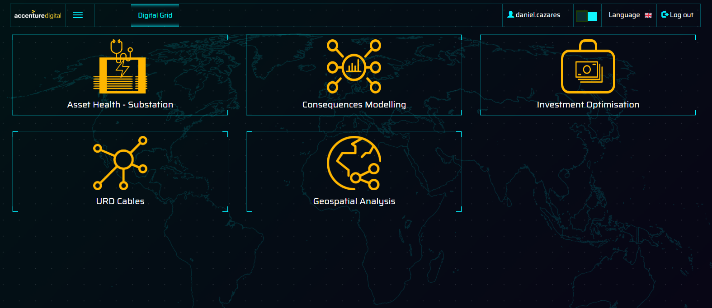
Digital Grid – Landing Page
This is the first screen user sees when logged in to the application
Here, user will have an option to select the business unit o interest. User can choose one from following:
f
Asset Health - Substation
Consequences Modelling
Investment Optimisation
URD Cables
Geospatial Analysis

Slide 8
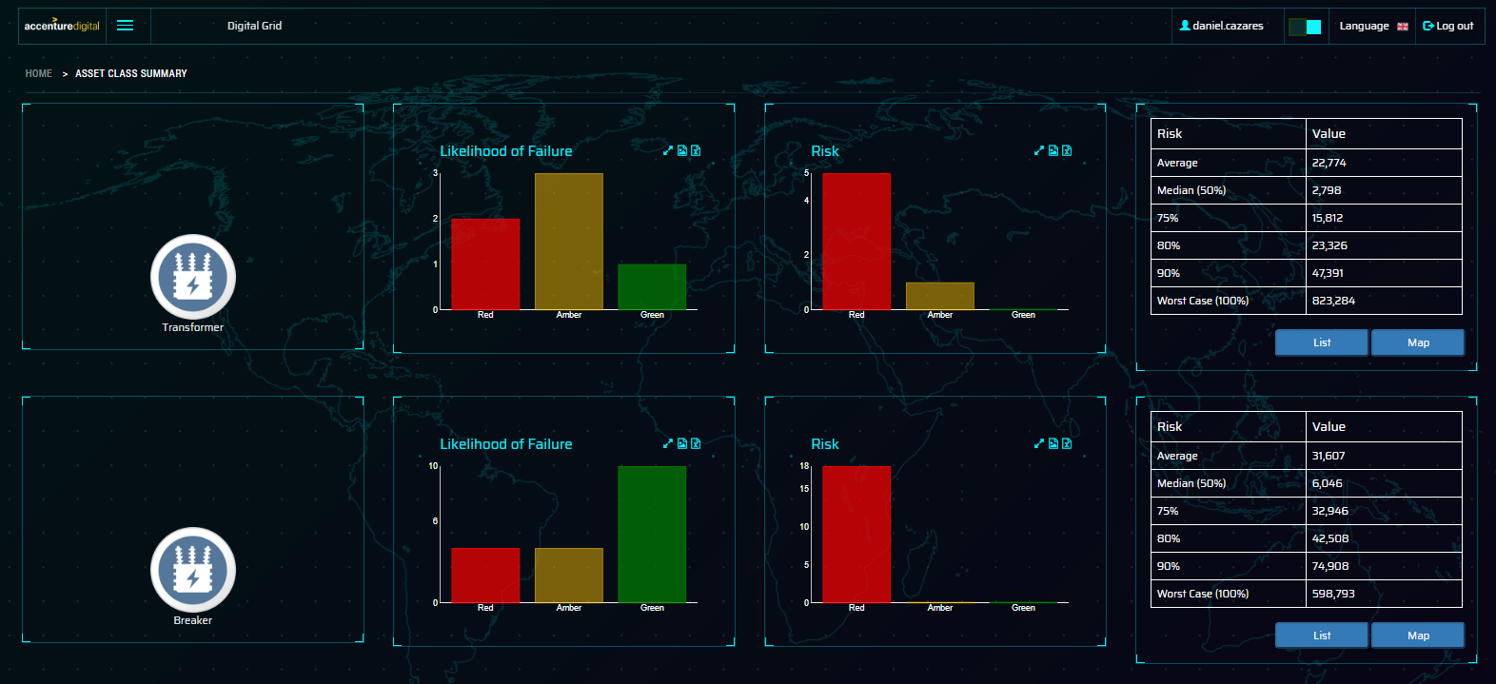
Asset Class Summary
The user lands on the main asset class summary page, this will show all the asset classes the user has authorisations to.
The icon shows the asset class in scope
Likelihood of Failure (LoF) – this graphic shows the percentage of assets within each of the RAG status with a total of the number of assets in each status shown in the numbers below
Risk – this is the % of assets within each RAG status for the risk valuation and the total number within each of the thresholds
The table shows the worst case valuation of risk that the fleet of transformers contains. This is displayed using recognised percentiles of average, median, 75%, 80%, 90% and worst case.
User clicks on the List button to view the Asset Class Details page

Slide 9
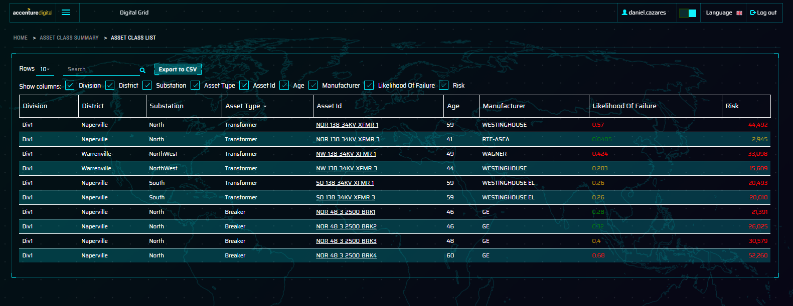
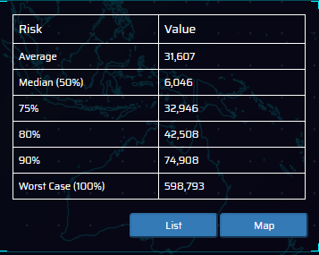
Asset Class List
The asset class list page details all the transformers in the fleet along with key pieces of information, such as Location, Transformer ID, Age, Manufacturer, Likelihood of Failure & Risk
Show columns allows user to hide columns not needed
Each column header can be clicked to sort the column in ascending / descending order
The transformer we are interested in for this demo is NW_138_34KV_XFMR_1
For this demo, we will click on the Digital Grid icon on the menu to go back to home page and click the Asset Health business unit , this will bring the Asset Class Summary screen (to show the map functionality)
When back on the asset class summary page click on the map button

Slide 10
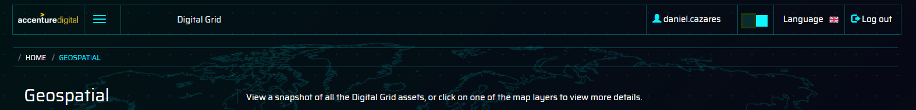
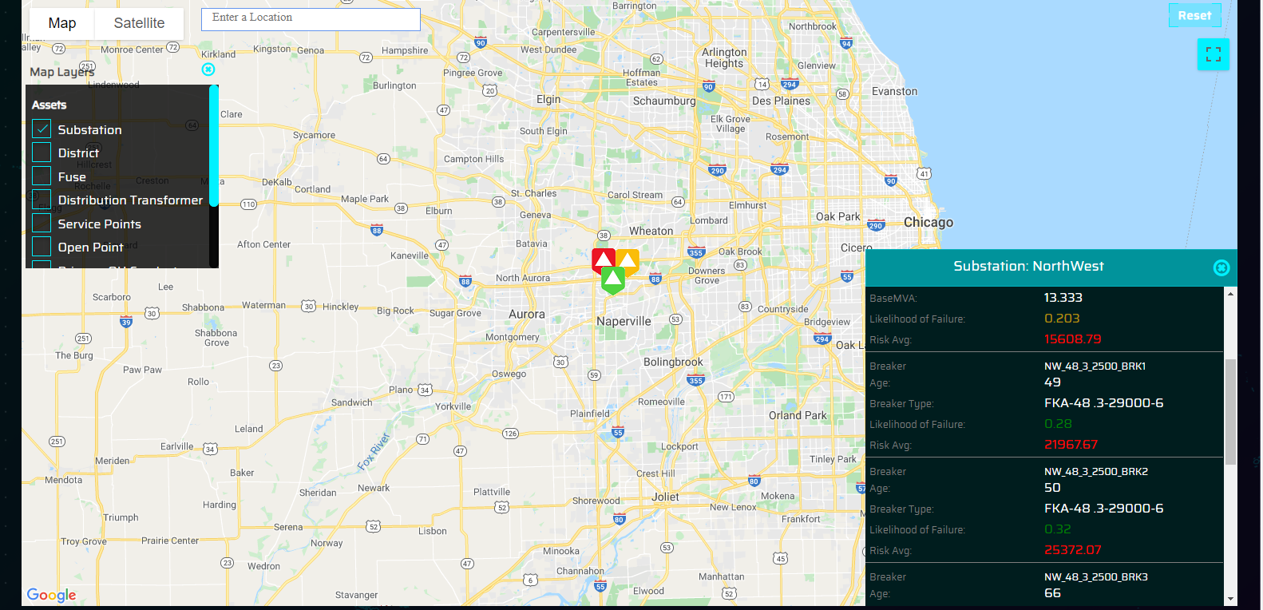
Asset Class Map View
The Geospatial view opens with a blank map of the service area in question.
Click on the Map Layers button to expose the drop down of the asset classes that can be filtered on. In this case, select Substations to show these on the map
We are interested in the substation coloured Red in the map view and click this to reveal the 2 transformers in this substation. As in the Asset Class list view, we are interested in NW_138_34KV_XFMR_1 transformer. Click on the hyperlink for this transformer to open the Asset Details page for Transformers
If the user clicks on one of the breakers they will be taken to a different Asset Details page for Breakers

Slide 11
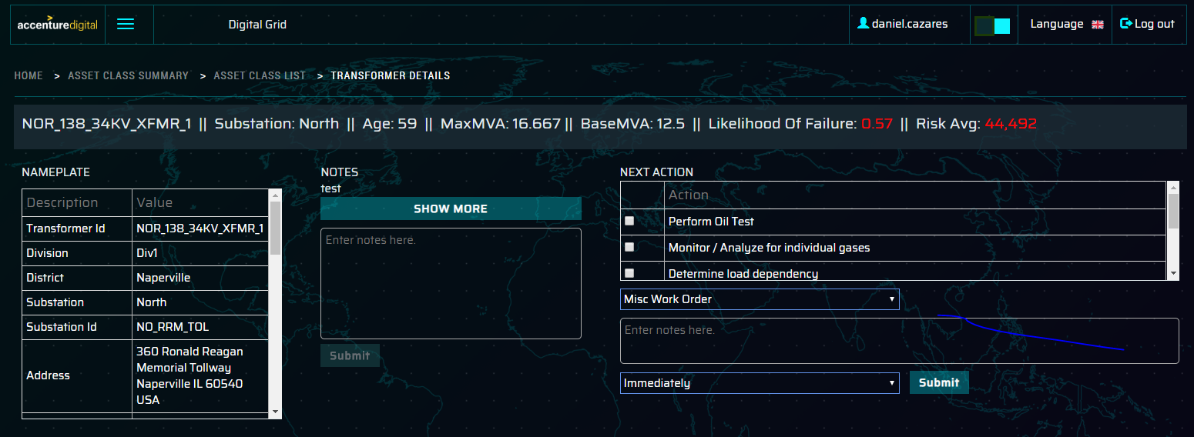
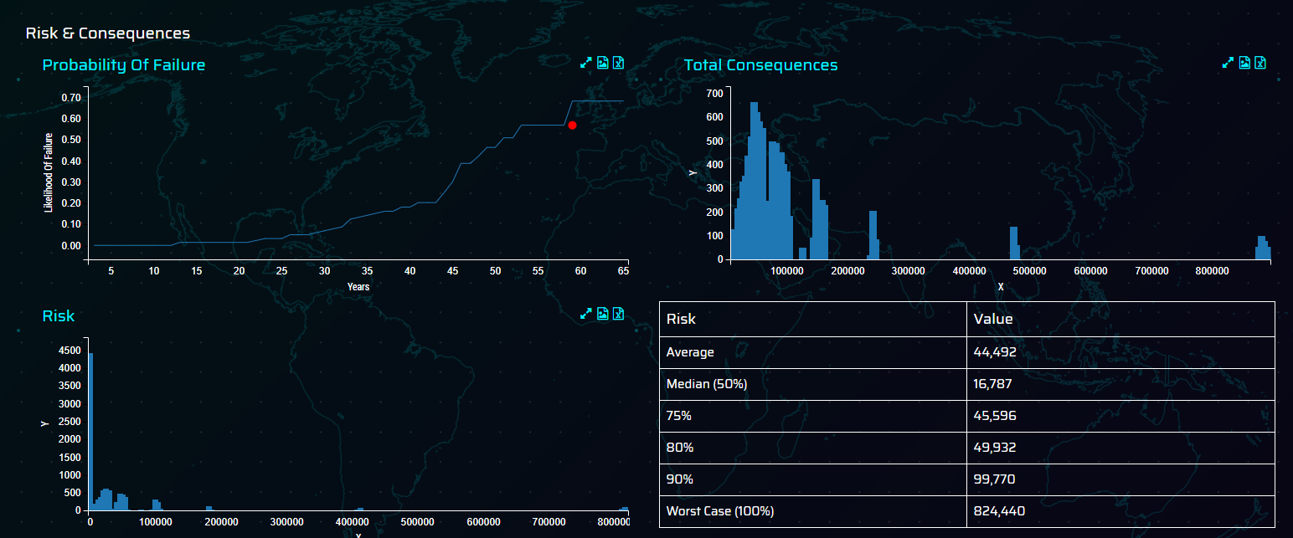
Asset Detailed View (Transformers1)
Asset detail view opens showing a lot of detail captured about the asset.
Floating Bar – this contains key pieces of information about the transformer that remains on top of the screen as the user scrolls down the screen
Nameplate – this shows the asset registry / nameplate information captured and typically consumed from the EAM system
Notes – view the most recent notes captured about
the transformer from the substation engineer
Next Actions – suggested actions for the transformer based on a recommendation engine
Risk & Consequences section
PoF of the transformer on the failure curve
calculated as part of the overall transformer fleet
Total consequences associated with distribution transformers
Risk calculated as the PoF * Total Consequences
Quartile valuation of risk shown in a table format
1
2
3
4
5

Slide 12
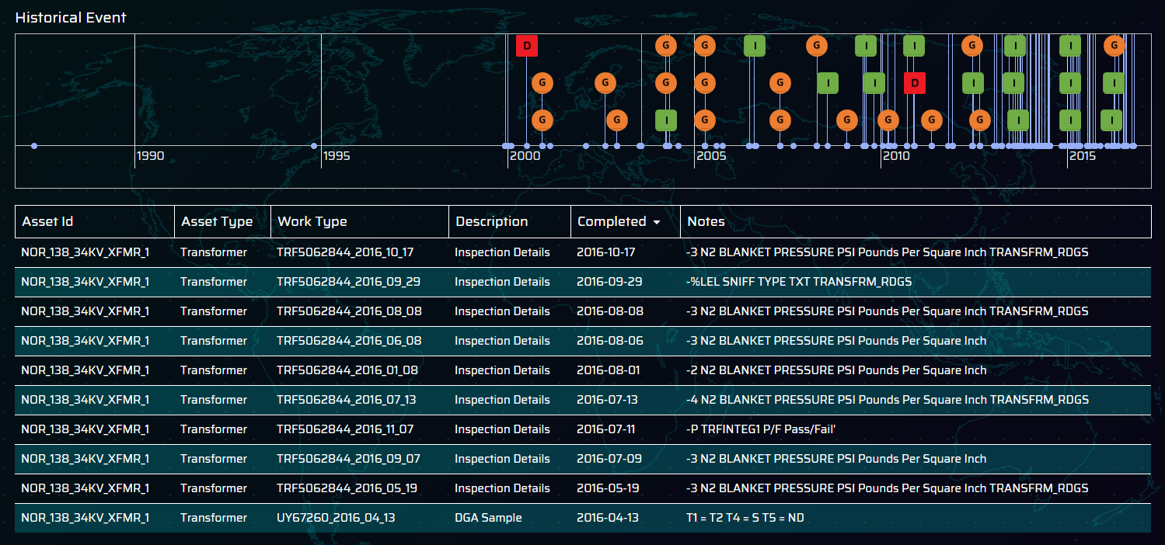
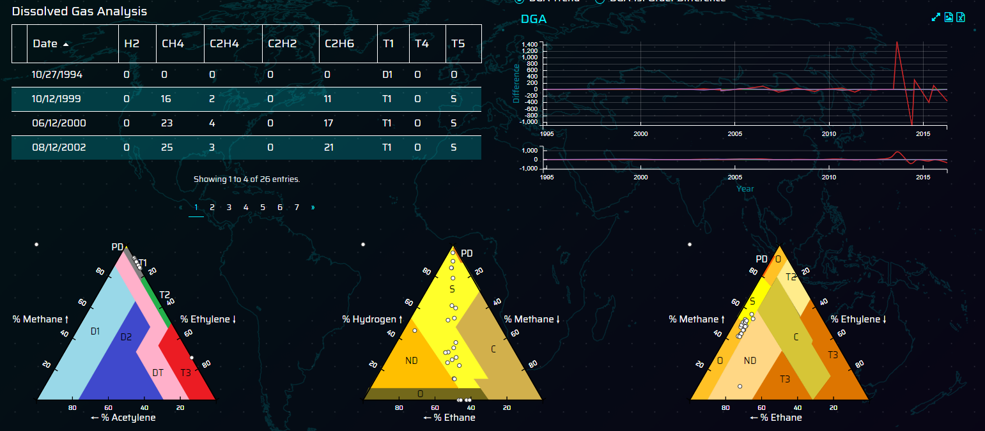
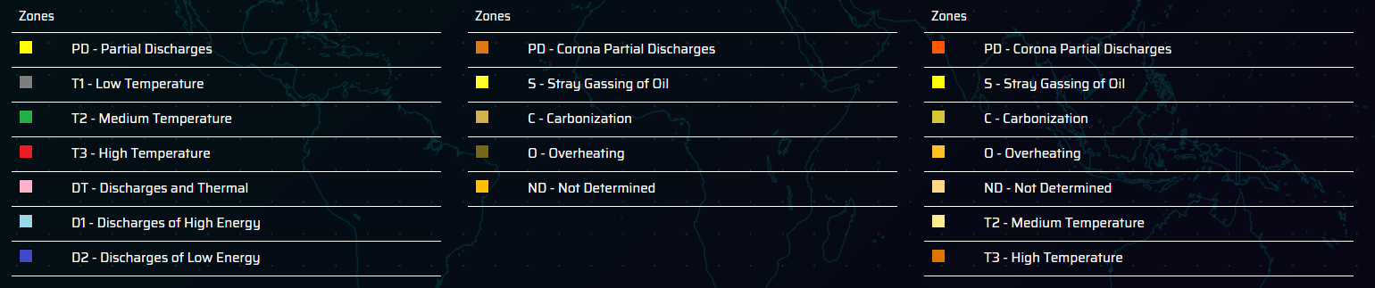
Asset Detailed View (Transformers2)
6
Continued from previous screen
Historical Events – The lollipop timeline shows all the major events recorded against the transformer from Work orders, inspections, gas measurements, outages etc.
DGA Table – table shows the actual dissolved gas readings over time along with the location of each in the Duval triangles (1,4 & 5)
DGA trend & 1st order difference – this graph shows the DGA trend and 1st order differences over the history of the readings, this helps identify the longer term trend of the DGA readings
Duval triangles (1,4 & 5) – shows the position of the readings based on the Duval methodology.
7
8
9

Slide 13
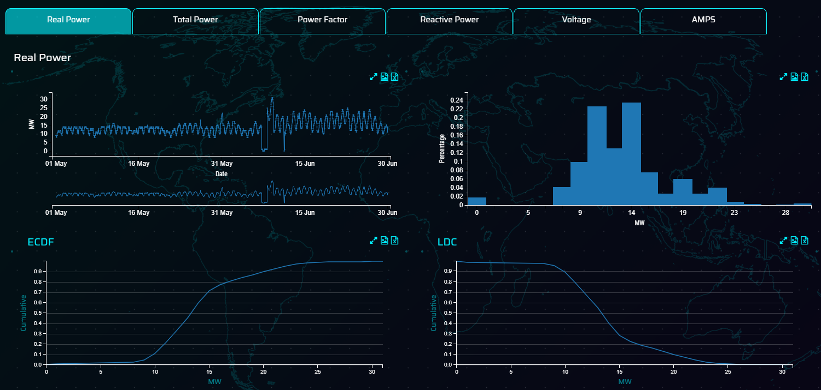
Asset Detailed View (Transformers3)
Continued from previous screen
Time-series analysis – This section shows an number of visualisations of the timeseries data for the transformer, the key measurements shown are
Real Power
Total Power
Power Factor
Reactive Power
Voltage
AMPS
A number of graphs are shown for each of the measurements
TS raw data values showing on 1 hourly intervals as captured from the historian system
Histogram of the TS data showing the distribution of values across regular sized intervals
Empirical Cumulative Distribution Function graph
Load duration curve
10
11
12
13
12 & 13 are shown only for real power and total power

Slide 14
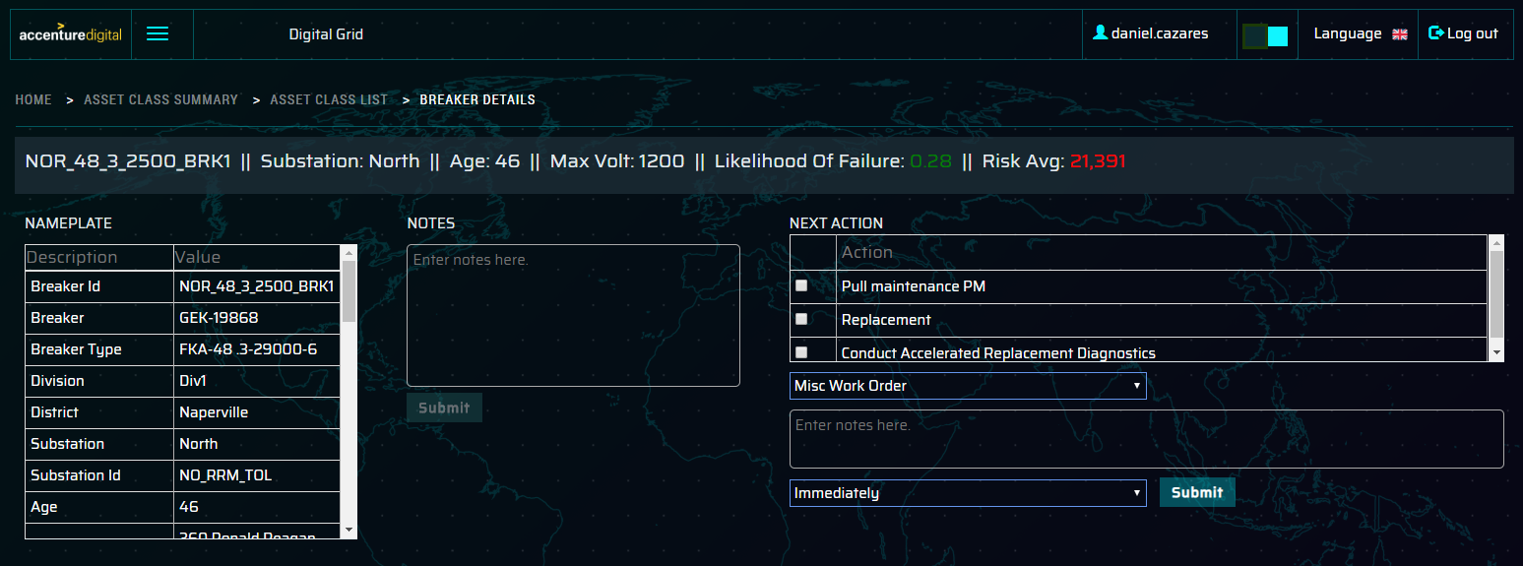
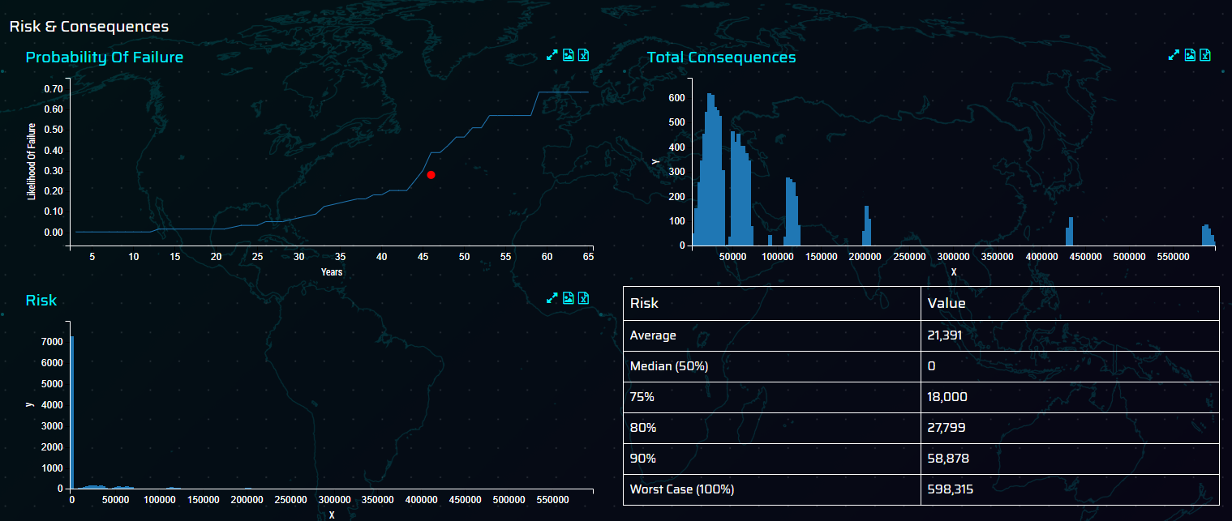
Asset Detailed View (Breakers1)
Asset detail view opens showing a lot of detail captured about the asset.
Floating Bar – this contains key information about the breaker that remains on top of the screen as the user scrolls down the screen
Nameplate – this shows the asset registry / nameplate information captured and typically consumed from the EAM system
Notes – view the most recent notes captured about
the breaker from the substation engineer
Next Actions – suggested actions for the transformer based on a recommendation engine
Risk & Consequences section
PoF of the breaker on the failure curve calculated as
part of the overall breaker fleet
Total consequences associated with distribution breakers
Risk calculated as the PoF * Total Consequences
Quartile valuation of risk shown in a table format
1
2
3
4
5

Slide 15
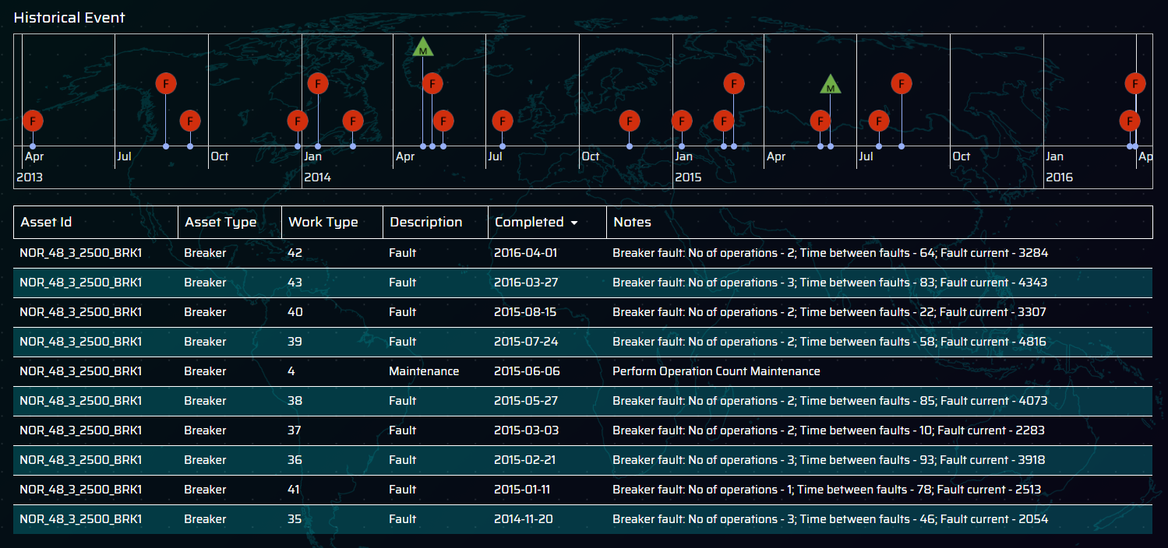
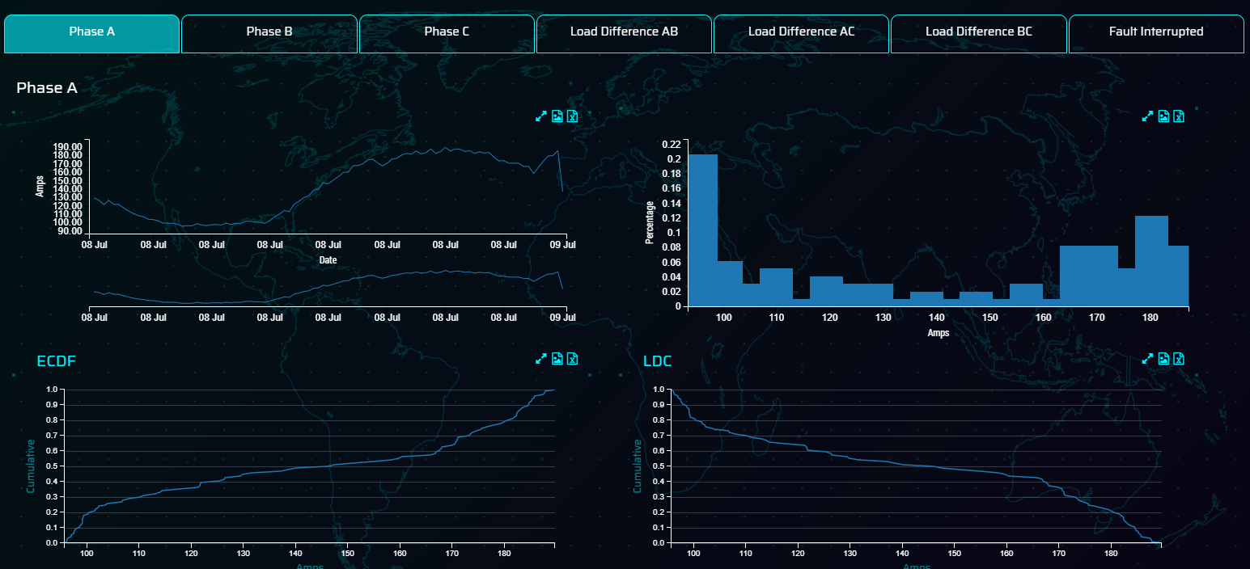
Asset Detailed View (Breakers2)
6
Continued from previous screen
Historical Events – The lollipop timeline shows all the major events recorded against the transformer from Work orders, inspections, gas measurements, outages etc.
Phase Loading by Phase (A, B, C)
TS raw data values showing on 1 hourly intervals as captured from the historian system
Histogram of the TS data showing the distribution of
values across regular sized intervals
Empirical Cumulative Distribution Function graph
Load duration curve
7

Slide 16
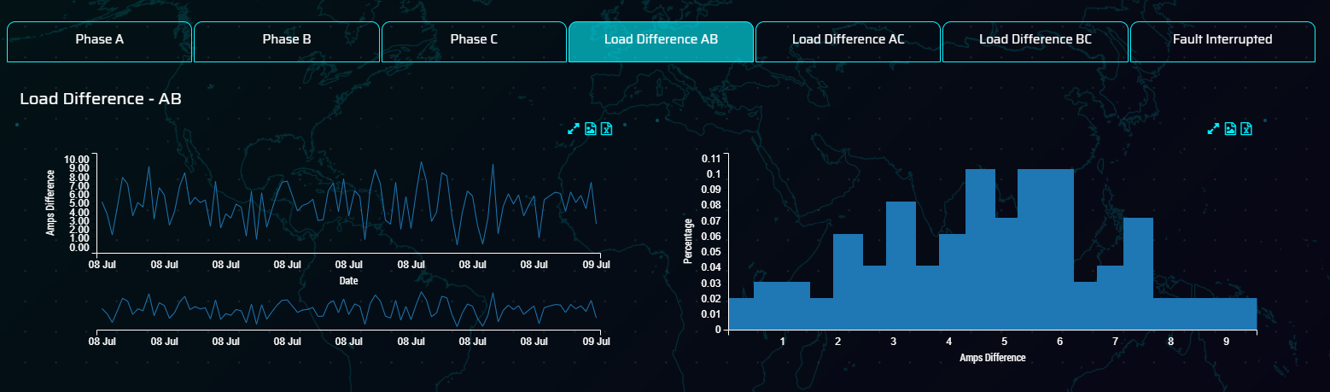
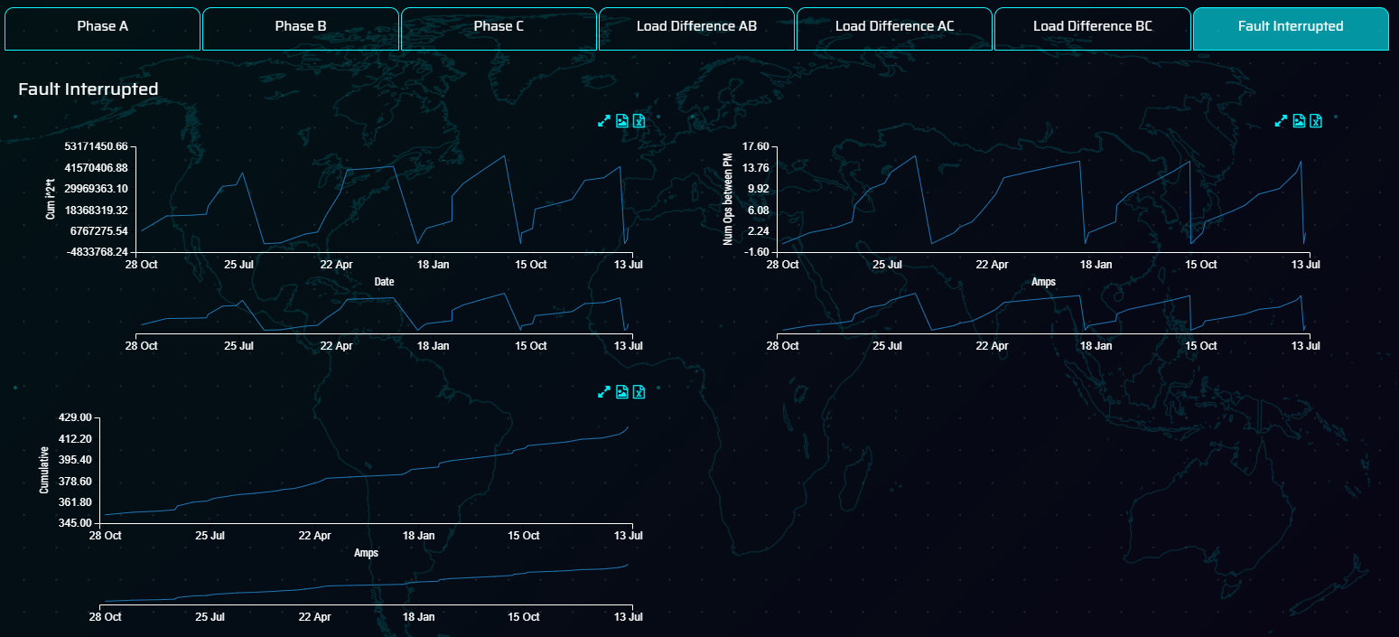
Asset Detailed View (Breakers3)
8
Continued from previous screen
8) Loading Difference AB, BC, AC– This section shows the phase loading differences between each of the phases, this is highlighted to show imbalances within the breaker phases
A number of graphs are shown for each of the measurements
TS raw data values showing on 1 hourly intervals as captured from the historian system
Histogram of the TS data showing the distribution of
values across regular sized intervals
9
9) Faults Interrupted – This section shows a number of fault measurements from the Breaker including
I^T cumulative faults interrupted
Number of operations between PM
Cumulative Operations from lifespan of the Breaker

Slide 17
ACCENTURE DIGITAL GRID
SCENARIO 2 – IDENTIFYING AND CHANGING THE CONSEQUENCES OF FAILURE AND RECALCULATING RISK
Sarah
Risk & Investment Manager
RECALCULATES RISK FOR NEWLY MAPPED TRANSFORMERS AND REVIEWS THE IMPACT THIS HAS ON THE OVERALL RISK FOR THE TRANSFORMER FLEET
REVIEWS THE TRANSFORMER LOF, CONSEQUENCES AND RISK
CLONE & EDIT EXISTING CONSEQUENCES SET
MAP CONSEQUENCES TO <20MVA TRANSFORMERS
SARAH STARTS HER DAY IN THE OFFICE
Logs into ADG and checks the risk calculations for a type of transformer. Tom has reported that the risk valuation is very high for a particular type of transformer in the fleet
Reviewing the Likelihood of Failure, Consequences of Failure and Risk associated, it is determined that the cost consequence for transformers <20Mva exceeds what would typically be incurred for this type of transformer
Sarah clones an existing set of consequences using the Transformers as the baseline.
Edits the costs consequences to reflect the lower cost consequences for <20MAV transformers and reviews the total impact.
Navigates to the consequence mapping screen and filters to the subset of transformers meeting the <20MVA criteria and maps the new consequences to this transformer.
Recalculates the risk for the transformers that have been remapped
Reviews the overall impact
that this has on the transformer risk and on the fleet of transformers in general.
REVIEWS IMPACT ACROSS ALL TRANSFORMERS

Slide 18
Digital Grid – Asset Management Demo scenarios
Scenario 2 – Asset Health (Consequences Modelling)
Engineer looks through the fleet of transformers and notices the risk on one of them is high but the consequences is too high / low for that type specification of transformers.
Creates a request to amend the consequences for any transformers
below a certain BaseMVA. User goes into the application, reviews the consequences for all transformers, determines that the cost (or another) needs to be amended but the rest can remain the same.
User clones the existing consequences and saves them to the system
User then edits the cost consequence for the <20Mva transformers and checks through the consequences and reviews the total impact and saves the consequences
User then maps the required transformers to the new consequences that were created. This is then saved and user given the option to recalculate all risks based on the revised consequences
User goes into the asset health for the changed transformers and reviews the consequences, these consequences are seen as more reflective of the situation for the transformer
Scenario 2 –Definitions
Consequence is defined as a probability distribution that reflects the consequences of a particular event happening to the asset. This is set on a current scale to enable normalisation however this could also be considered risk points.
Consequence Set – This is a number of individual consequences aligned to those laid out by the utility, in this instance we have configured the consequence set as Cost, Reliability, Safety and Total Impact.

Slide 19
Digital Grid – Landing Page
This is the first screen user sees when logged in to the application
f
Here, user will have an option to select the business unit of interest. User can choose one from following:
Asset Health - Substation
Consequences Modelling
Investment Optimisation
URD Cables
Geospatial Analysis

Slide 20
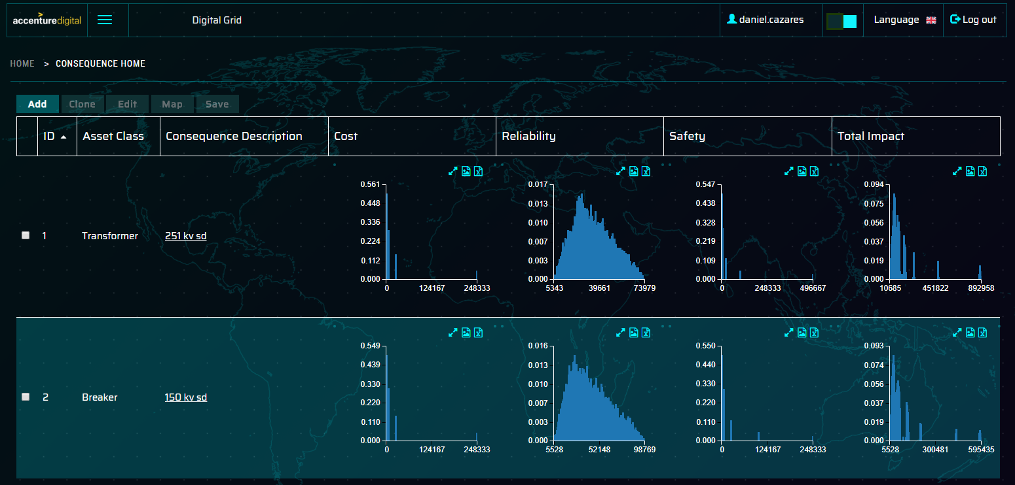
Consequence Modelling Screen Overview
Menu Options
Add – create a new set of consequences
Clone – clone an existing set of consequences
Edit – edit an existing set of consequences
Map – Map the consequence set to individual assets with the option to recalculate the risk based on the changed consequences
Save – save any amendments to the consequences
ID – Unique identifier for the consequence set
Asset class that the set of consequences is to be associated with
Consequence description to denote the asset subclass that this consequence set should be applied to
Cost, Reliability, Safety – probability distribution for each of the individual consequences
Total Impact – sum of the individual consequences
1

Slide 21
Asset Detailed View (1)
In the asset detail view the substation engineer views a transformer and notices that the risk value is very high considering the Likelihood of Failure.
They raise a request to change the consequences of failure for any transformers where the BaseMVA is below a certain threshold.

Slide 22

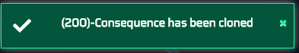
Consequence Modelling Screen
The consequences modelling screen opens on the main page showing the main consequences for each of the major asset classes in scope.
Risk manager highlights the asset class / consequence and clicks on the clone button to duplicate this asset class.
Risk manager will be prompted for a Consequence description to set it apart from the existing ones and clicks save
A message then appears confirming that the consequences have been cloned

Slide 23
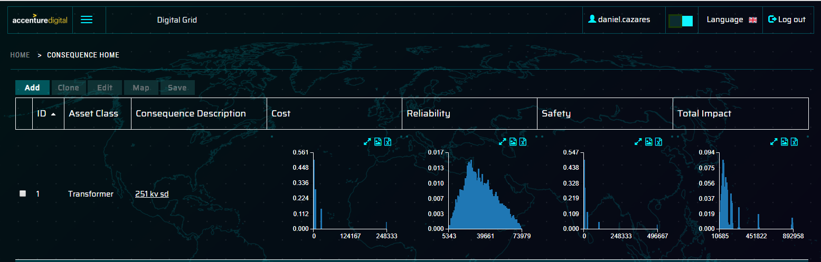
Consequence Modelling
Once cloned the new set of consequences are available in the Consequence Modelling screen
To Edit the consequence description, check the record to be changed and click on the Edit button to edit the Consequence Description
To access the consequence details screen, click on the hyperlink for the consequence description

Slide 24
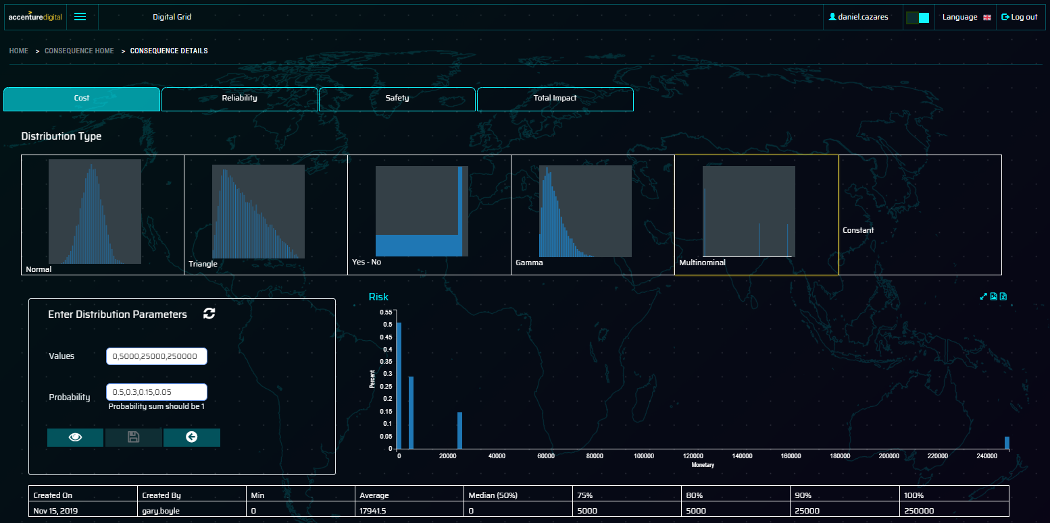
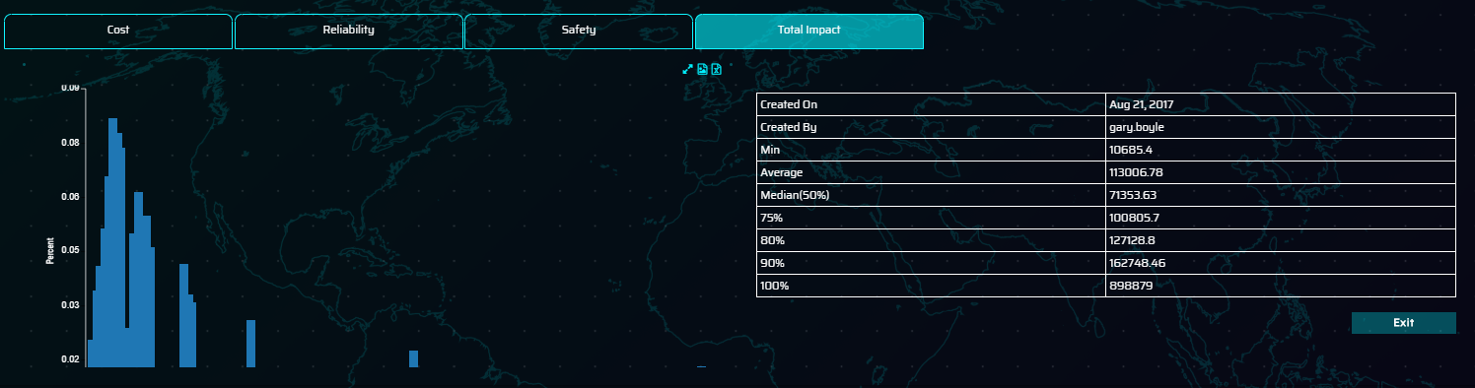
Consequence Modelling
The consequence modelling screen contains the following sections
1
2
Tabs showing the consequence categories (Cost, Reliability, Safety) and Total Impact
The type of probability distribution that is being used for the consequence (Normal, Triangle, Yes / No, Gamma, MultiNominal or Constant)
Depending on the type of distribution selected, the distribution parameters will differ
Histogram graph shows the 10,000 value random probability distribution shown in 150 bins
Table shows the information on when it was cxreated and percentile information (Average, Median, 75%, 80%, 90% and 100%)
The total impact tab, contains the sum of the individual consequences and the percentiles.
3
4
5
6

Slide 25
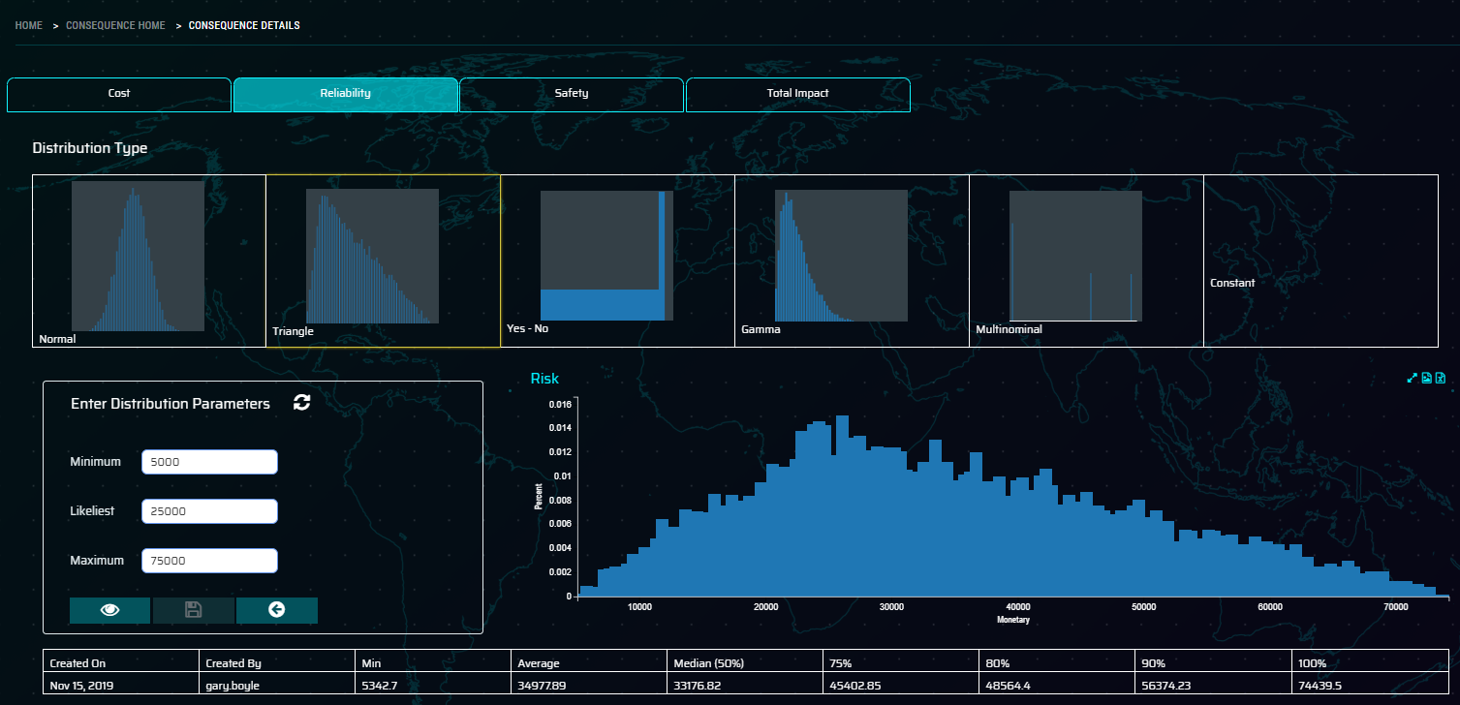
Consequence Modelling
Within the scenario the user selects the relevant consequence that they wish to change. In this case reliability will be changed.
Select the distribution type if a different one is required, this case we will select Triangle and enter the required parameters Minimum, Likeliest and Maximum
Click on the View button to view the updated distribution with the revised parameters
Once this is acceptable, click on the save button to save
this distribution as the default for this distribution set.
If not needed then click Exit which will close the screen without saving this distribution.
Check the remaining tabs and especially the Total Impact in the final tab and click exit to return to the Consequence main screen
Select the updated consequence using the check box and click on the Map button

Slide 26
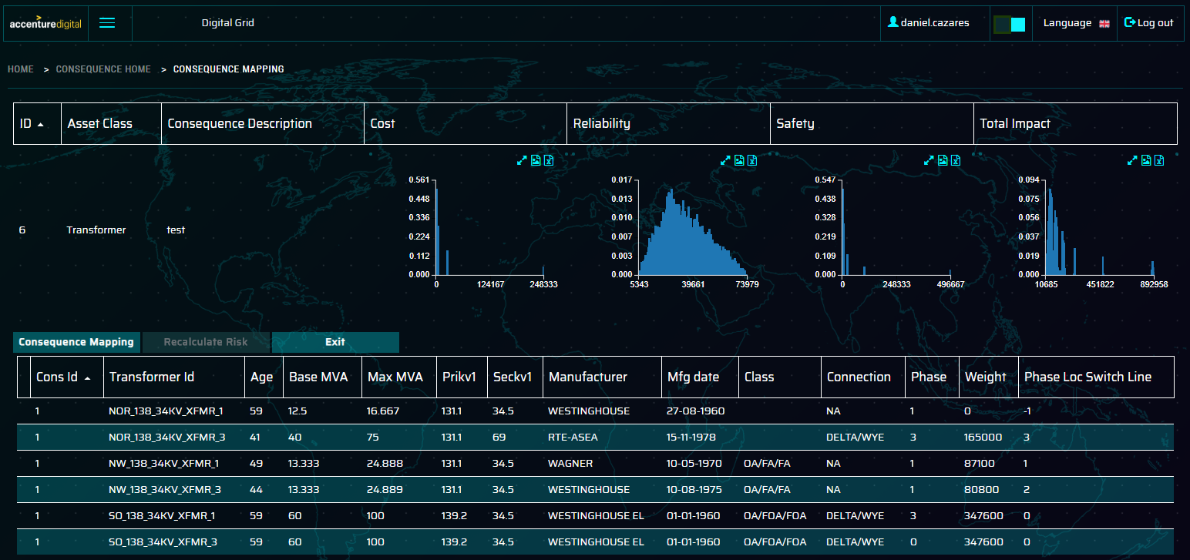


Consequence Modelling
On the Consequence Modelling landing page, select the updated consequence using the check box and click on the Map button
This opens the Mapping screen showing the consequences and the assets that this can be mapped to.
Filtering options are available for the assets to filter by Age, Manufacturer and asset specific measures
Once filtered, user selects assets to be mapped by clicking on the check box. Once all selected, click the Consequence Mapping button to remap. Once complete this shows the message shown.
Recalculate Risk button then becomes active to allow user to recalculate the underlying risk associated with these assets on the new consequences.
Once risk has been recalculated, the following message appears

Slide 27
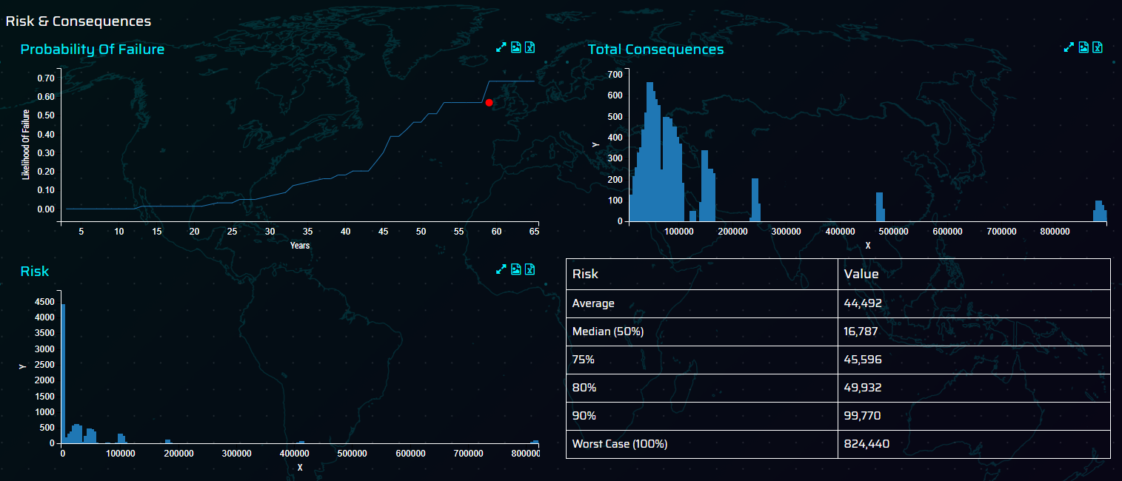
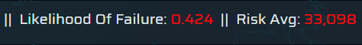
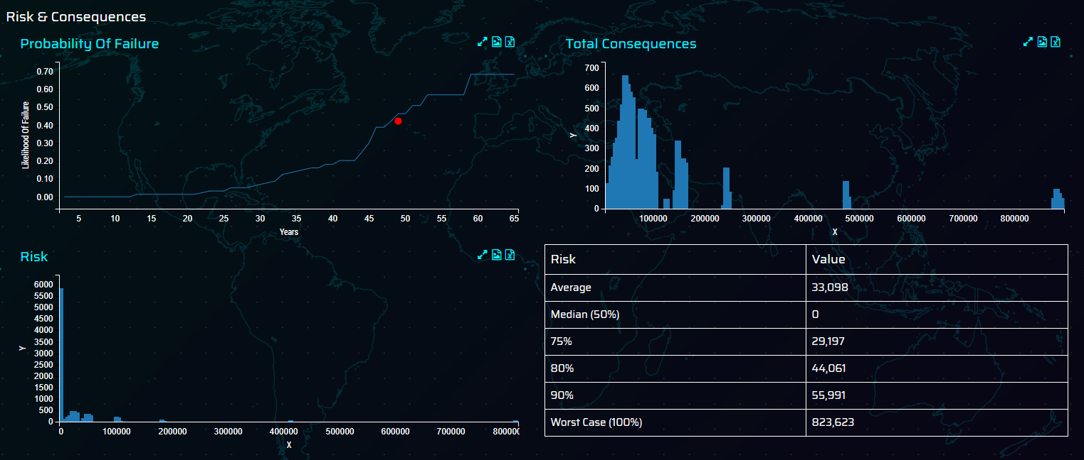
Consequence Modelling
After remapping the consequences then return to the original asset and view the updated Risk Average and the other percentile risks associated with it

Slide 28
ACCENTURE DIGITAL GRID
SCENARIO 3 – INVESTMENT OPTIMISATION
Sarah
Risk & Investment Manager
SARAH REVIEWS THE EXISTING OPTIMISATION SCENARIOS WITHIN IO APP
REOPTIMIZE THE SCENARIO AND CONDUCT SCENARIO COMPARISON
CLONES AN EXISTING SCENARIO TO MAKE CHANGES
AMEND SCENARIO LEVEL CONSTRAINTS
AMEND PROJECT LEVEL CONSTRAINTS
Accesses the IO application and reviews the existing scenarios that have been created.
Requested to make some
amendments to the scenario based on feedback in the review rounds
Clones an existing scenario and uses this as the baseline scenario to make the changes to
Accesses the new scenario and makes a number of changes to the overall budget amounts available in each of the years and the minimum allocation % for the regions
Following feedback, changes a number of the project level constraints including
Projects being mandatory
Projects being required to be completed in certain years
Reoptimizes the scenario and reviews the portfolio key metrics to determine if this is a better scenario based on the changes requested.
SCENARIO IS DISTRIBUTED TO BE REVIEWED AND APPROVED

Slide 29
Digital Grid – Asset Management Demo scenarios
Scenario 3 – Investment optimisation
Investment optimisation analyst reviews the available scenarios in
the IO application
Clones an existing scenario and edits the scenario name
Edits the scenario configuration parameters including:
Changes the budget amounts in the configuration screen
% allocation of budget to each of the regions
Amends the years some projects can take place in and makes one
of the project mandatory
Once happy with the changes that have been made the analyst solves the scenario in the system
Returns to the scenario overview page and reviews the results of the scenarios.
Creates a filter on a number of the scenarios and eventually choses
one to be reviewed by the project managers for progression into
the next years plan

Slide 30
Digital Grid – Landing Page
This is the first screen user sees when logged in to the application
f
Here, user will have an option to select the business unit of interest. User can choose one from following:
Asset Health – Substation
Consequences Modelling
Investment Optimisation
URD Cables
Geospatial Analysis

Slide 31
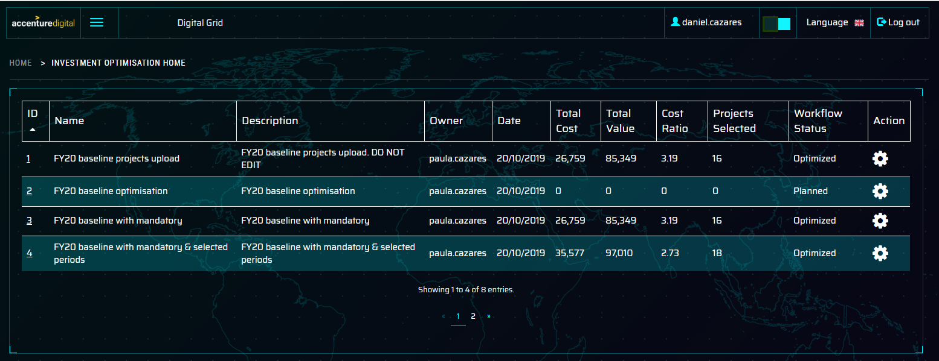
Scenario Overview
The investment analysts reviews the existing list of investment scenarios and decides to create a new scenario based on feedback received from an investment approver
Analyst navigates to the scenario in question and clicks on the cog icon to open the configuration screen for that particular scenario

Slide 32
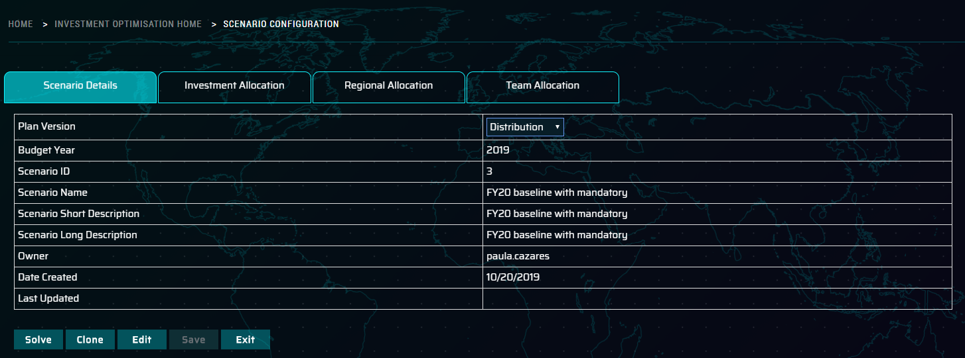
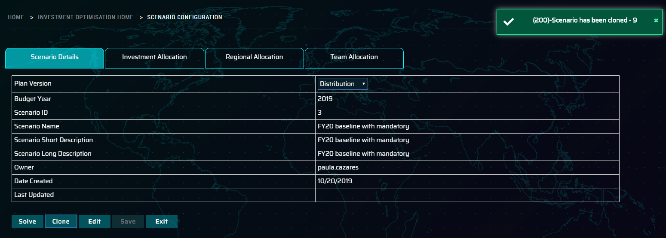
Scenario Configuration
The configuration screen will open with the selected scenario on display.
Analysts selects the Clone button to create a clone of
this scenario
Once the system has cloned the scenario a message will appear telling the user that the scenario has been cloned and giving the new scenario ID
User Navigates back to the Scenario Overview screen by
clicking on the Exit Button.
The user navigates to the new Scenario ID and clicks on the configuration button to get back the Scenario Configuration page

Slide 33
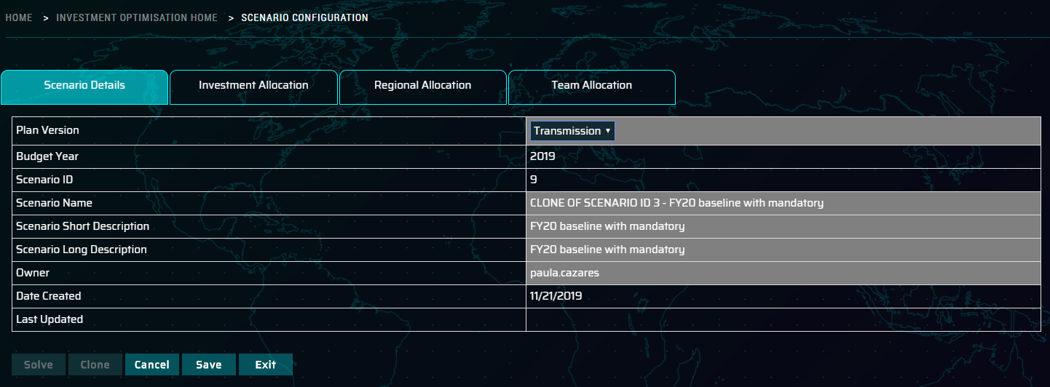
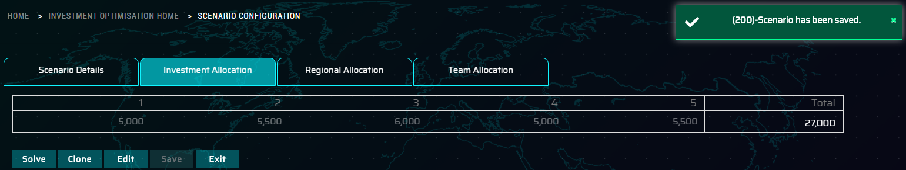
Scenario Configuration
Analyst clicks on the Edit button (once clicked this changes to Cancel). This shows a number of fields that can be edited, such as name & descriptions.
Update the name and description and click save
Select Investment Allocation tab and adjust the budget amounts in each period to flex the potential budget available. (Recommend changing the budget by 1m per period to show a difference in the optimisation outcome)
Click Save to get a Scenario has been saved message
Click Exit to return to the Scenario Overview page. Click on the details hyperlink for the new scenario to access the Scenario Details page

Slide 34
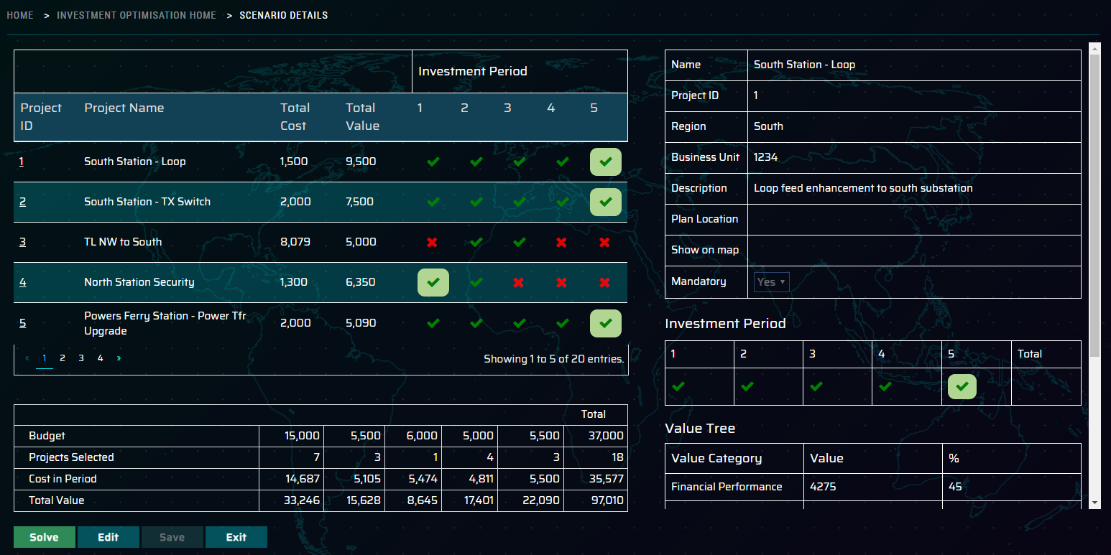
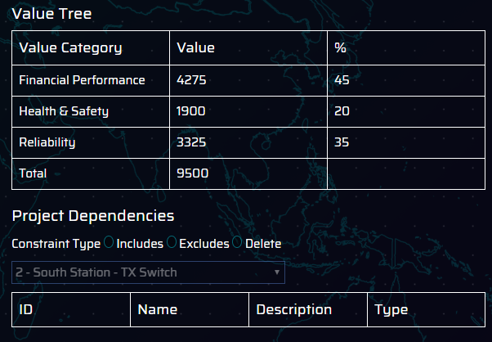
Scenario Details Page
1
Scenario details page is made up of several sections
2
All projects in the scenario are listed along with the cost, value and periods the project can be selected in
Project Description – high level details on the project
Investment periods that the project can be selected in
3
Value tree – breakdown of the value in each of the consequence categories
Project inclusion / exclusion dependencies
Summary information on the scenario
If the project has not been solved this will contain total budget for the scenario and the breakdown by period of this. The Solve button will show in blue
If the project has been solved, the solve button will appear in blue and additional information will appear for the summary info including the projects selected, costs, total value against budget
4
6
5

Slide 35
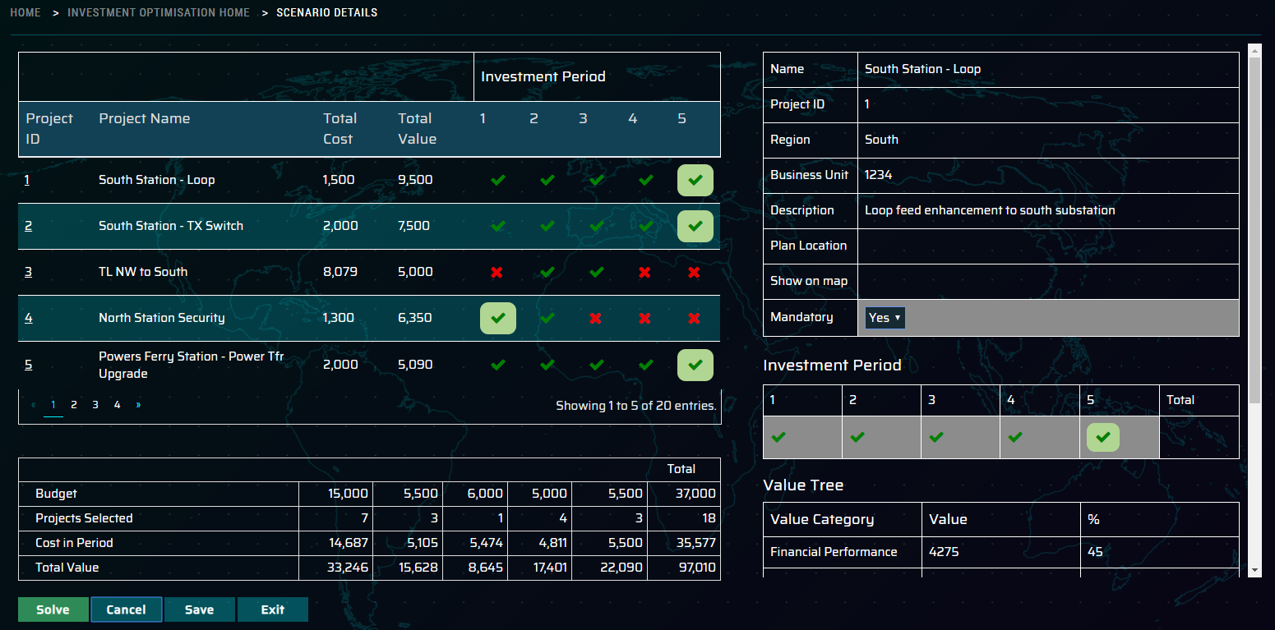
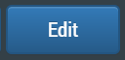
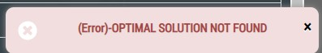


Scenario Details Page
To make changes to a particular project, click on the Project ID and the right hand panel will refresh
Select the Edit button, a number of highlighted fields will then show to enable editing. Make the appropriate changes to the project selections, such as
Project mandatory – yes / no option
Investment Period selected – these need to be continuous periods
Inclusion / Exclusion constraints.
Inclusion – where Project 1 AND project 2 need to be selected together.
Exclusion – where project 4 OR project 5 can be selected (Either or, not both)
Once complete, select save. This will trigger this message.
To solve the project, click on solve button, the will update as follows
If the optimisation routine cannot solve the optimisation then the following message will occur.
In this case, the only solution is to modify the criteria in order to solve it
message

Slide 36
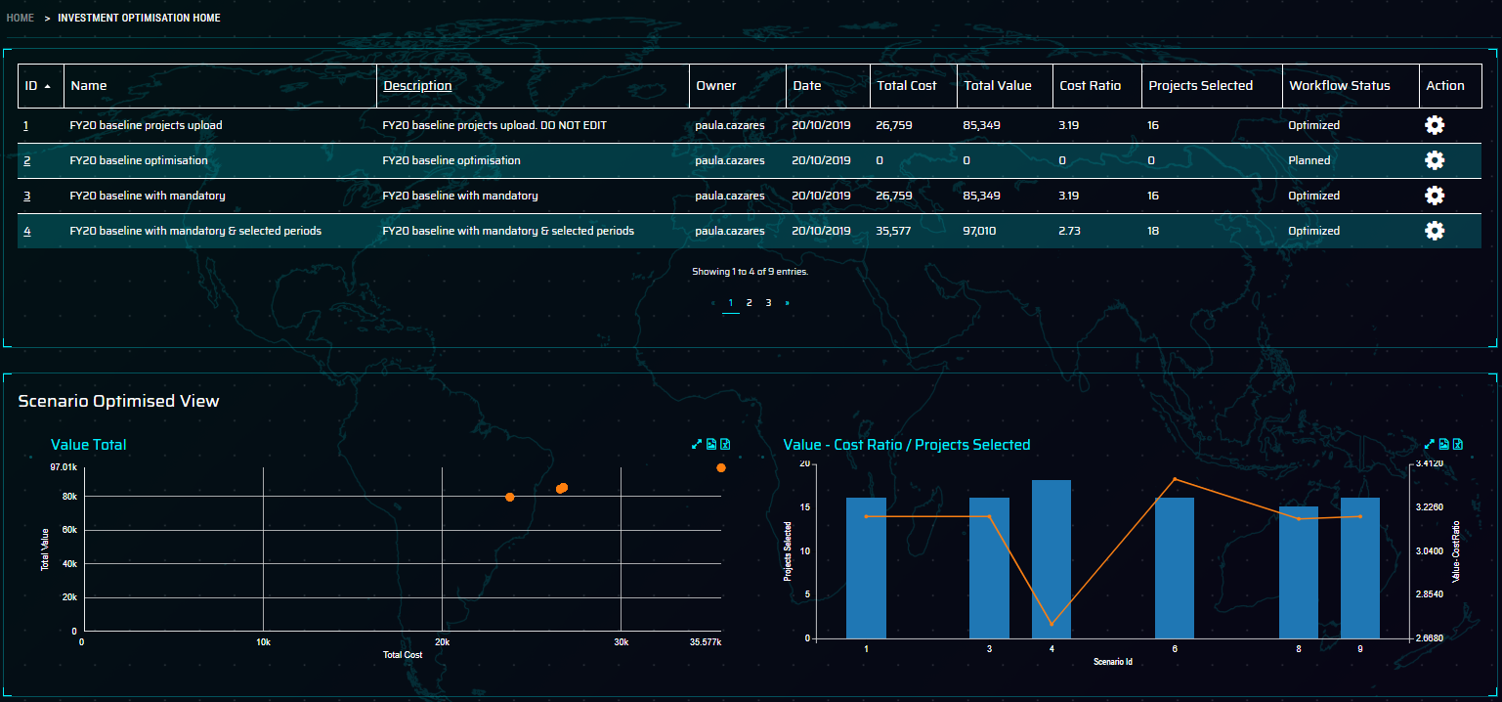
Scenario Overview – Scenario Optimised View
Once a number of scenarios have been solved, return to the scenario overview screen to view the results initially in a table view. Filtering can be applied to this table
Total Value against Total Cost scatter plot shows the curve of total cost against value, this can be used to highlight where the benefit exceeds others
Value – cost ratio & projects selected shows the value to cost ratio and the number of projects selected in each of the scenarios. This enables the analyst to determine the best scenarios to go forward with.

Slide 37
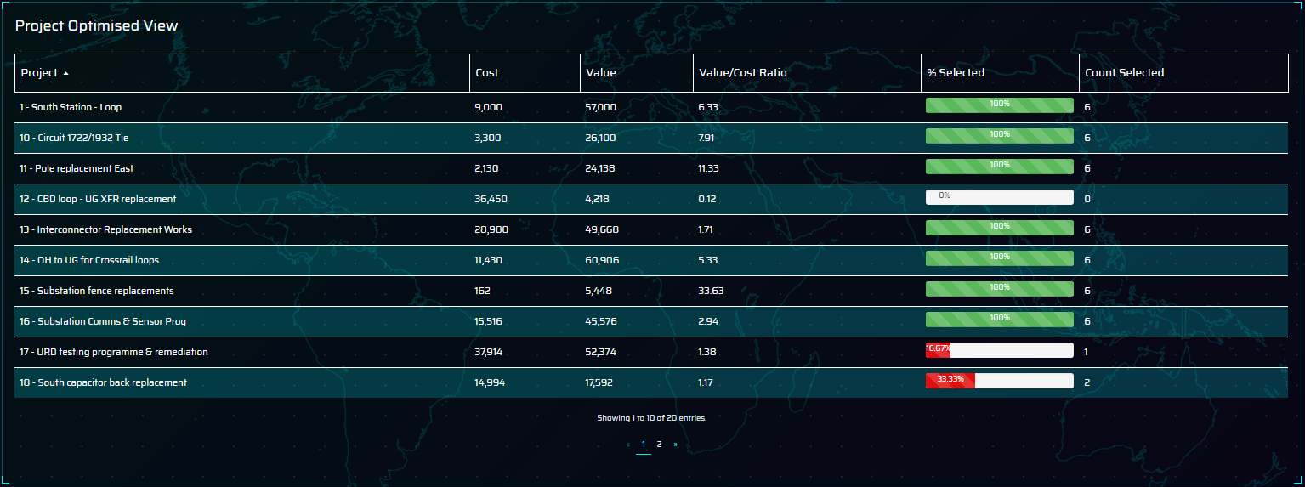
Scenario Overview – Project Optimised Vie
w
The Project Optimised View enables the analyst to see the projects that are selected most often, the cost, value and value to cost ratio.
This view enables the analyst to check on the projects that should always be considered and helps refine the view on statistically the most popular projects from an optimisation perspective.

Slide 38
ACCENTURE DIGITAL GRID
SCENARIO 4 – DISTRIBUTION ASSET HEALTH URD LOOPS
Wayne
Distribution Engineer
REVIEWS THE AGGREGATED METER DATA FOR THE TRANSFORMERS TO UNDERSTAND BETTER THE OVERLOAD
WAYNE REVIEWS THE LOOP POPULATION AND FILTERS THE OVERALL LIST TO SHOW THE HIGHEST PRIORITY LOOPS
MODEL 5 YEAR LOAD FORECASTING TO AND ITS IMPACT ON THE SYSTEM & RECOMMEND A COURSE OF ACTION
DETERMINES A COURSE OF ACTION TO CARRY OUT ON THE LOOP AND RECORDS NOTES
SELECTS A SINGLE LOOP TO ANALYSE
Overall loop list is shown with ability to filter on the high priority loops for further investigation
Engineer reviews the LoF, Severity and Risk of the loop. Assesses the historical events to have occurred and looks at the overall loop makeup
Using the aggregated meter to transformer data as a proxy for load, the engineer can see if the transformer is overloaded along with indicators of duration and intensity. Also view voltage sag / swell events if the meter captured this
Engineer finally utilises the load forecasting tool to determine the 5 year load growth based on parameters that they are able to configured at calculation time.
After reviewing all the available data and forecasting the load the engineer selects a recommended action and records the notes against the transformer.
DISTRIBUTION ENGINEER PROCEEDS
TO ANALYSE NEXT LOOP

Slide 39
Digital Grid – Asset Management Demo scenarios
Scenario 4 – Distribution Asset Health URD Loops
Distribution engineer reviews the asset health calculations for all
the URD loops in their area
Filters and sorts the list to show the highest risk loops and starts investigations using the risk, outage, work order and associated meter data
Selects a single loop and reviews the data for LoF, severity and Risk
Selects a single transformer and reviews the timeseries data
derived from all meters associated to the transformer. Reviews the
Load, Voltage patterns and KVA Above & KVA Above Hours.
In determining the potential load on the system, uses the load modelling algorithm built into the system to give a view on peak loads on that transformer in 5 years time.
Following the review the decision is made that this Loop will be scheduled for an inspection and remediation plan put in place to upgrade a number of transformers on the loop to a higher capacity following the analysis.

Slide 40
Digital Grid – Landing Page
This is the first screen user sees when logged in to the application
f
Here, user will have an option to select the business unit of interest. User can choose one from following:
Asset Health – Substation
Consequences Modelling
Investment Optimisation
URD Cables
Geospatial Analysis

Slide 41
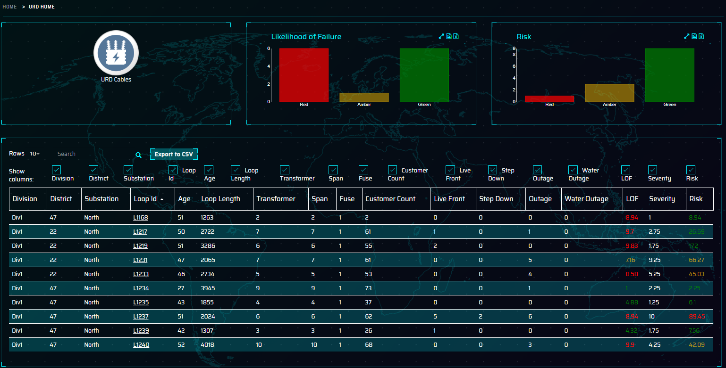
URD Summary View
The user lands on the main asset class summary page, this shows all the URD looks in the population. There are a number of main sections to view
Likelihood of Failure – graph shows the number of loops where the Likelihood of Failure is within certain configurable thresholds
Risk – graph shows the overall Risk score for the URD loops where they fall within certain configurable thresholds
Table view gives a number of high level details for each of the loops including
Name plate info, age & length
Number of assets on the loop (fuses, transformers & spans)
Key severity measures – customers, equipment characteristics & outage counts etc
Risk measures – LoF, Severity and Risk calculations
User clicks on Loop 1217 to view the URD Loop
Details data.

Slide 42
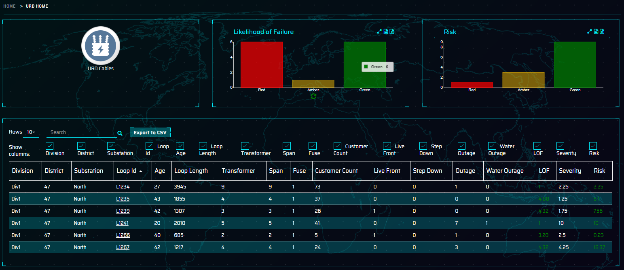
URD Summary View – Filter Options
Continued from previous screen
Engineer clicks on the Likelihood of Failure and Risk graphs to dynamically filter the population of loops
Can select a column header to sort ascending / descending
Finally clicks on the LoopID hyperlink to view the details of the loop

Slide 43
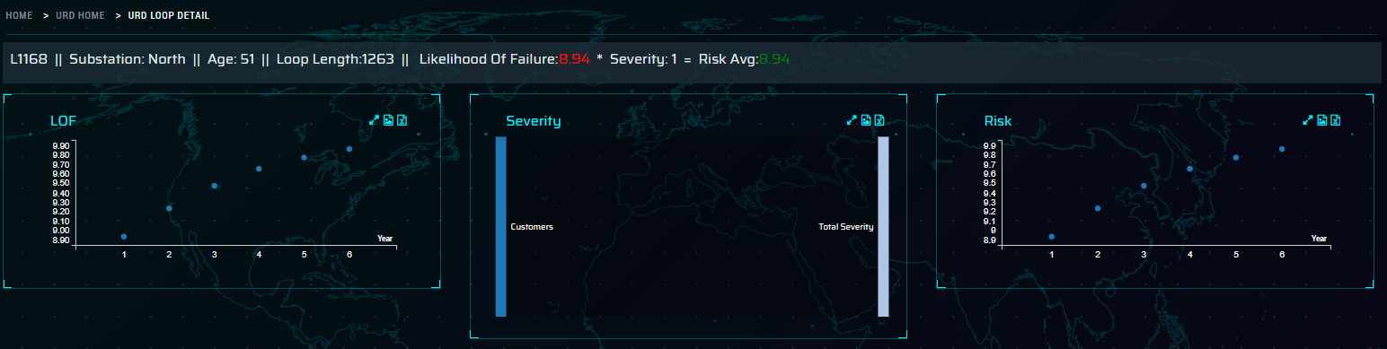
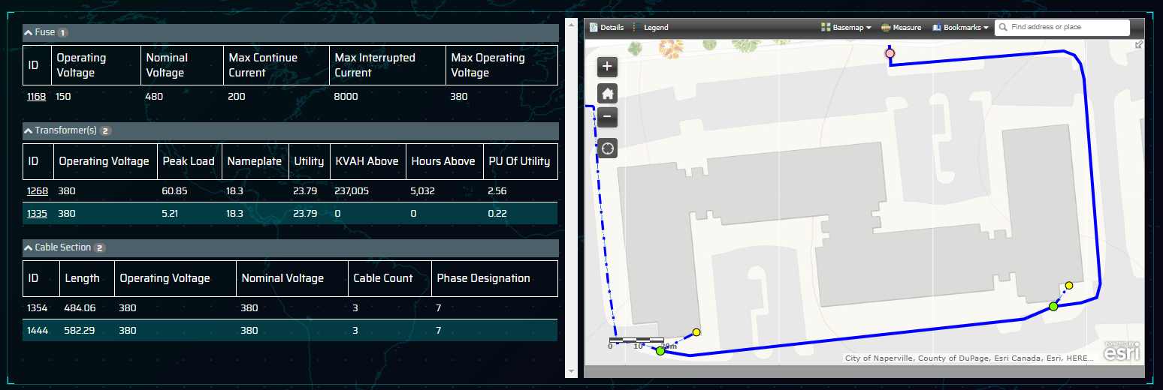
URD Detailed View (1)
1
The URD Cables detailed page opens showing the following sections
Header Bar – lists out the Loop ID, Substation area,
Age, Length, LoF, Severity and Risk for the Loop
Likelihood of Failure (LoF) forecasted out for the next 5 years
Overall severity and how much the constituency parts feed into the overall severity for the loop. In this example the overall severity is made up of Customer (1.25) + Outage (1) + LiveFront (0.5) = Overall Severity (2.75)
Risk forecasted out for the next 5 years based on Risk = LoF * Severity
Hierarchy component view for the Loop, split by asset type including key information for each of the components
Embedded ESRI view of the loop. This is directly linked to the client ESRI system to ensure tight integration between ESRI and the ARIS application. User can click in the Hierarchical view or the map icons to select a transformer to view additional sensor data.
2
3
4
5
6

Slide 44
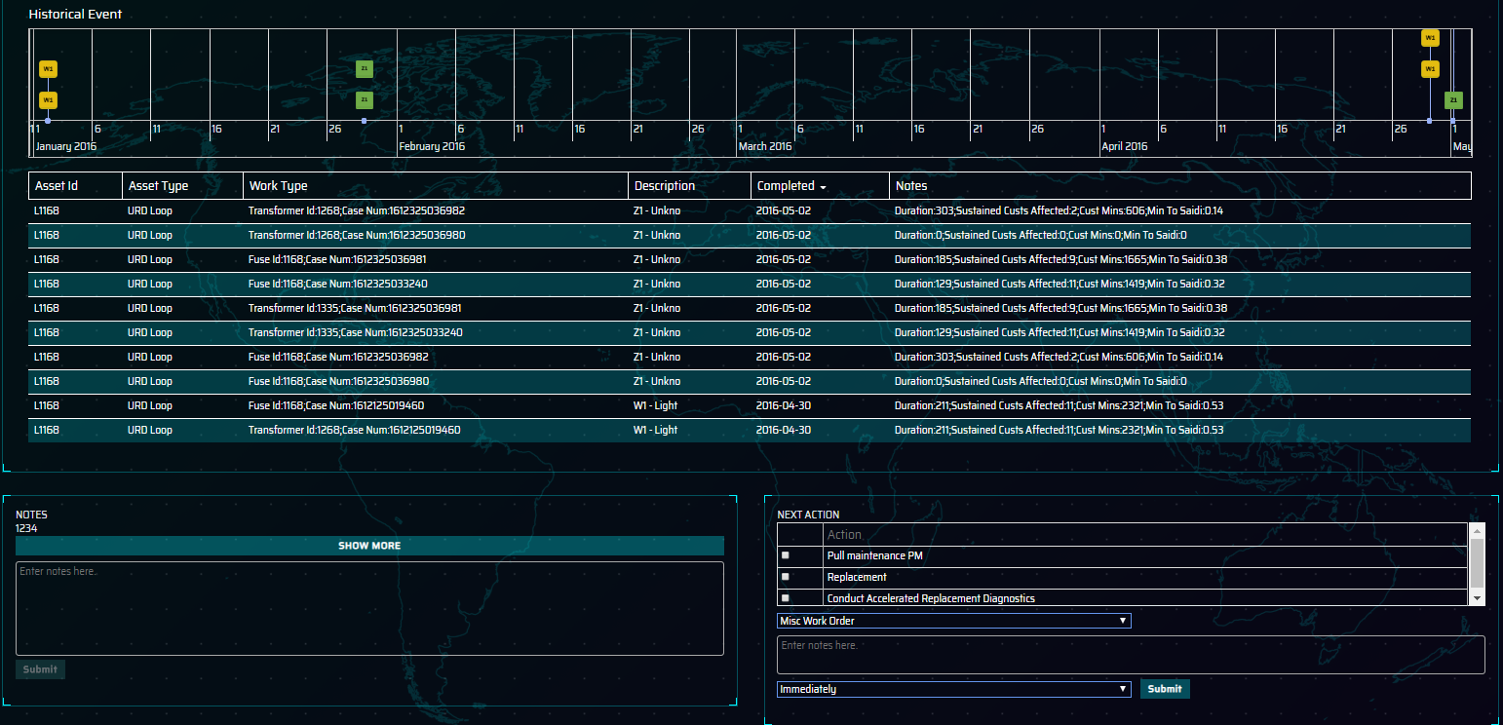
URD Detailed View (2)
Continued from previous screen
Historical Events – The lollipop timeline shows all the major events recorded against the URD loop including outages and work orders & inspections. The timeline can be zoomed into to allow a more granular view
Notes section – Notes section can be utilised to hold comments, observations and notes related to the loop.
Next actions – based on the findings from the inspection, a work order can be raised by clicking on the next action. This will be integrated with the work order management system.
7
8
9

Slide 45
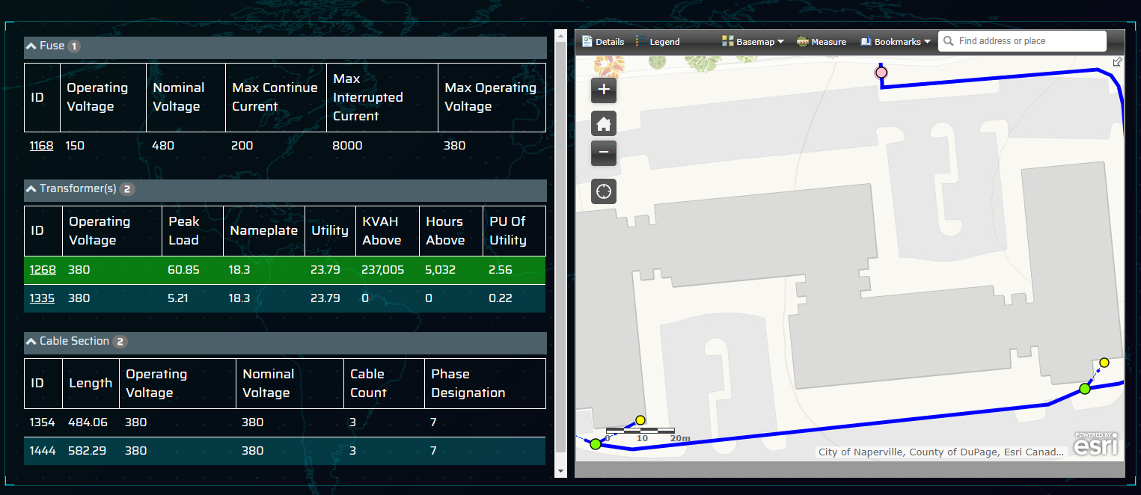
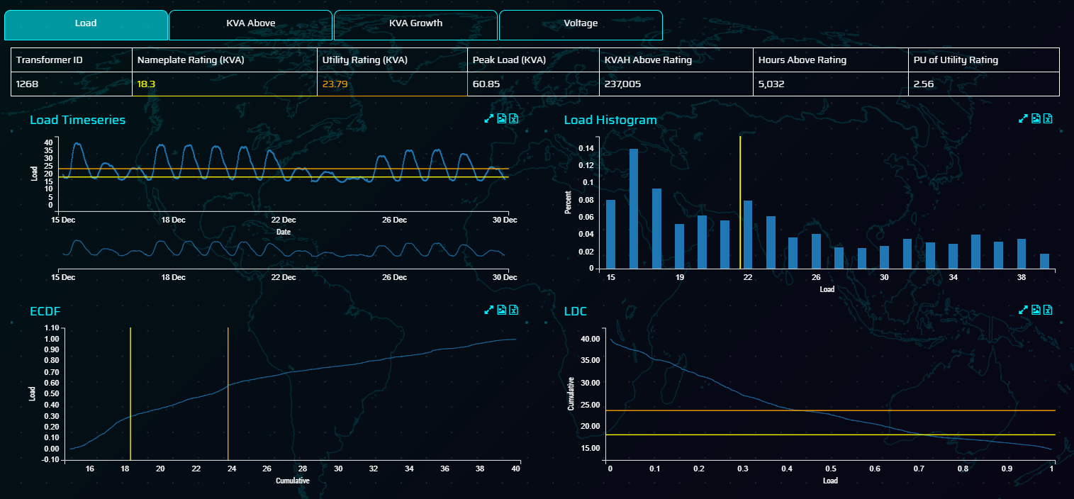
URD Detailed View (3)
Continued from previous screen
Hierarchy Component View – Additional sensor data can be accessed when clicking on the transformers in the component hierarchy. The map view will zoom to highlight the transformer selected and also show the secondary cables and attached meters to the transformer
Transformer Timeseries analysis section will open to allowing the user to view a number of metrics calculated by aggregating the data provided by smart meters utilising the transformer meter mapping.
Load data is shown as timeseries data, histogram, ECDF and LDC. The yellow and amber lines represent the nameplate and utility rating for the transformer. This helps the user quality to determine the level of overload on the transformers in the system.
10
11
12

Slide 46


URD Detailed View (4)
13
Continued from previous screen
KVA Above – Calculated as the total KVA Above Rating and the Hours Above Rating calculated on the daily aggregated meter data. These give an indication of the intensity and duration of the overload on the transformer
Voltage is shown where voltage data is captured for a meter on the loop. This shows the voltage normalised at 1, and patterns over the last 14 days and over the last year to give an indication of sag / swell events on the transformer.
14

Slide 47

URD Detailed View (5)
Continued from previous screen
15) KVA Growth – This section allows the distribution engineer to model load growth on the transformers in the loop at an individual level. The modelling parameters are:
15
Increased base load growth in either KVA or % increase
Trend growth using linear additive forecasting by a %
increase in each year
Forecasting years allows the engineer to model growth and view the results at the end of the x year period. For simplicity this is limited to 5 years in this demo.
The graphs will show the yearly max KVA + growth over the next 5 years alongside the Load Duration Curve of the results in 5 years time. This will allow the engineer to make planning decisions within the application without needing to use a separate application.

Slide 48


URD Detailed View (5)
Continued from previous screen
16) Engineer selects a recommended action to conduct accelerated replacement diagnostics on the loop and a recommendation that it is placed for immediate replacement following the inspection. Engineer also updates the notes with the findings from the inspection to ensure clear visibility.

Slide 49
ACCENTURE DIGITAL GRID SCENARIO 5 – GEOSPATIAL ANALYSIS
Wayne
Distribution Engineer
REVIEWS THE AGGREGATED METER DATA FOR THE TRANSFORMERS TO UNDERSTAND BETTER THE OVERLOAD
WAYNE REVIEWS THE LOOP POPULATION AND FILTERS THE OVERALL LIST TO SHOW THE HIGHEST PRIORITY LOOPS
MODEL 5 YEAR LOAD FORECASTING TO AND ITS IMPACT ON THE SYSTEM & RECOMMEND A COURSE OF ACTION
DETERMINES A COURSE OF ACTION TO CARRY OUT ON THE LOOP AND RECORDS NOTES
SELECTS A SINGLE LOOP TO ANALYSE
Overall loop list is shown with ability to filter on the high priority loops for further investigation
Engineer reviews the LoF, Severity and Risk of the loop. Assesses the historical events to have occurred and looks at the overall loop makeup
Using the aggregated meter to transformer data as a proxy for load, the engineer can see if the transformer is overloaded along with indicators of duration and intensity. Also view voltage sag / swell events if the meter captured this
Engineer finally utilises the load forecasting tool to determine the 5 year load growth based on parameters that they are able to configured at calculation time.
After reviewing all the available data and forecasting the load the engineer selects a recommended action and records the notes against the transformer.
DISTRIBUTION ENGINEER PROCEEDS
TO ANALYSE NEXT LOOP

Slide 50
Digital Grid – Asset Management Demo scenarios
Scenario 5 – Geospatial Analysis
Distribution engineer reviews the asset health calculations for all
the URD loops in their area

Slide 51
Digital Grid – Landing Page
This is the first screen user sees when logged in to the application
f
Here, user will have an option to select the business unit of interest. User can choose one from following:
Asset Health – Substation
Consequences Modelling
Investment Optimisation
URD Cables
Geospatial Analysis

Slide 52

Geospatial home page view
A map will be displayed by default along with the transformers highlighted in Red, Amber and Green colours based on their PU of Utility rating values.
User can then click the filter button on map to open the filter panel and apply certain parameters to view different values of transformers.

Slide 53

Geospatial home page view
Filter panel opens to with default of PU of Utility Rating showing.
Use the drop down on Load Criteria to view the other transformer specific metrics that can be configured. In this case we have the following:
Nameplate rating – standard rating from transformer manufacturer
Utility Rating – many utilities will allow a level of overloading on transformers (in this case 30%)
Peak Load – highest individual load on the transformer over the last year
PU of Utility Rating – Peak Unit of utility rating, the
factor overloaded on the utility rating
Kvah above rating – Total kvah overload on the transformer for data over the last year (intensity of the overload)
Hours above rating – total hours where the transformer was overloaded (duration of the overload)

Slide 54

Geospatial home page view
This application allows the user to define threshold values for Red, Amber & Green status.
Select the min / max value of underload and min/max value for overload. Click on the search button to refresh the display. The Amber category will be determined as the range from the Max of the Underload to the Min of the overload.
This allows the user to select different parameters for the transformers in use whilst doing analysis

Slide 55



Contact
Kausar Qazilbash
Global Lead – Resources Digital Platforms, Resources Analytics
kausar.qazilbash@accenture.com
Gary Boyle
Digital Grid Technology Lead Gary.boyle@accenture.com
Rohit Banerji
Resources Digital Platforms Functional Lead rohit.banerji@accenture.com

